Slide 1
Mapping Black Lives Matter Protests, 2014-2020
Neomi Rao
PLSC31101
Notes:
I wanted to collect BLM protest data by date and location with 2 primary goals:
1. Create pretty visualizations of BLM protest location data
2. Prepare a dataset protest with location & date data or future analysis against the various measures

Slide 2
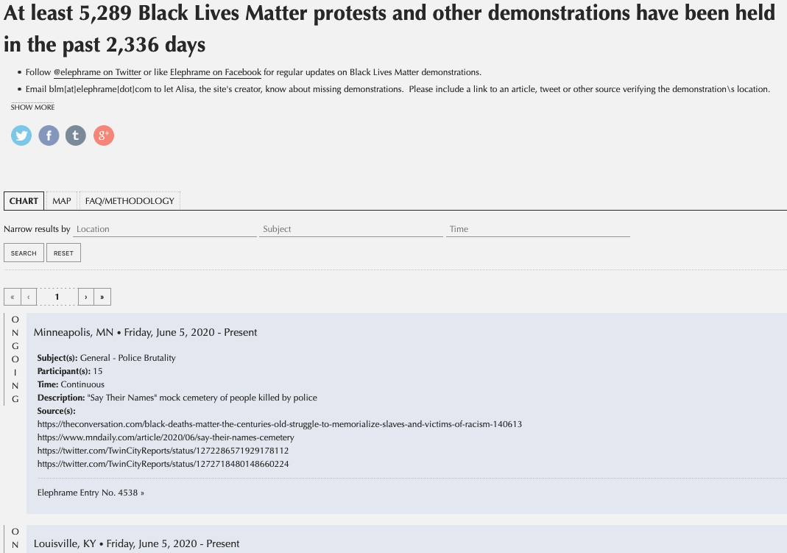
Webscraping with Rselenium()
Notes:
Issue: site hosting BLM data uses dynamic JavaScript for table – so cannot be scraped with just Rvest
Solution: RSelenium automates browser clicks
Caveat: can still be finicky based on speed of internet connection and may require manual adjustment

Slide 3
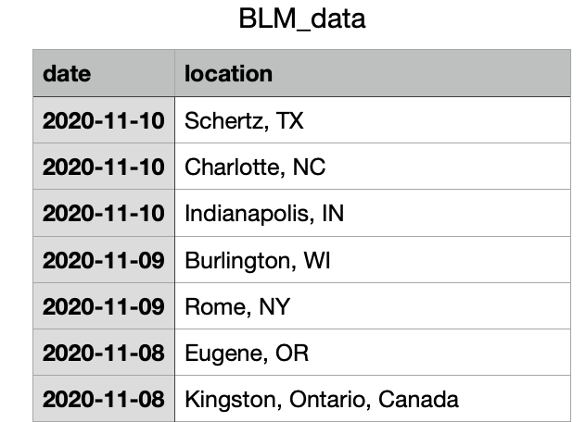
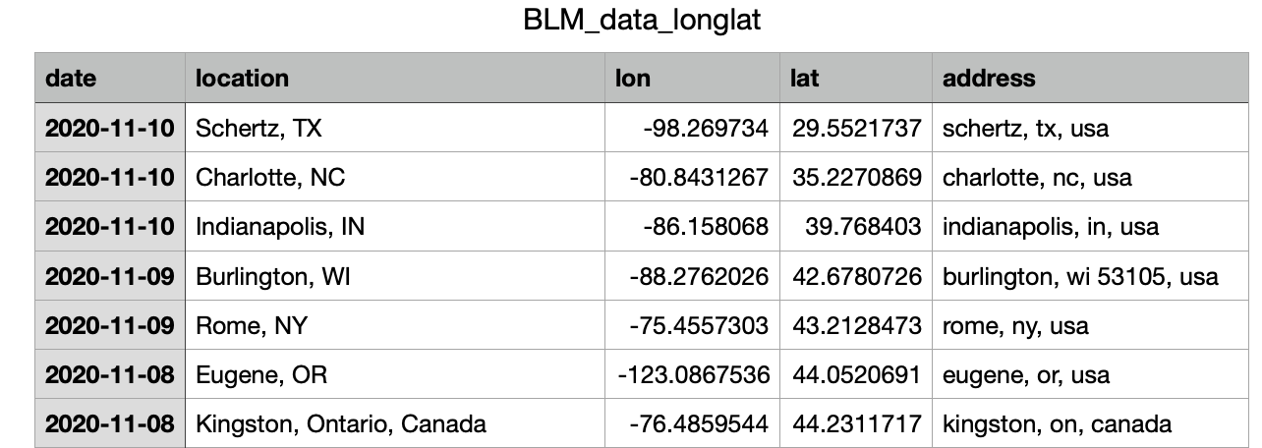
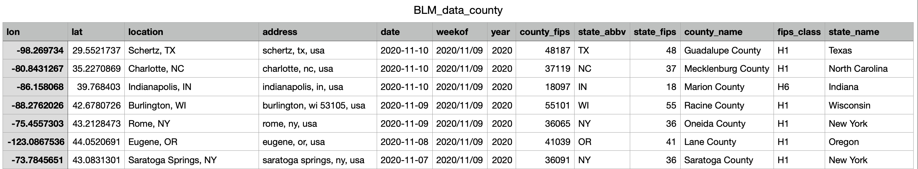


Geolocation with Google Map API (GGMAP())
Notes:
Issue: raw scraped location data only gave general city / state / country information – no lat, long, or consistent address
Solution: ggmap() takes location data, runs it through the Google Map API and gives you lat, long, and the google map address
Caveat: Google API requires payment information and only gives you $200 worth of free API usage per month, so be careful not to overuse the API.
Once I had long/lat data, I could do additional spatial manipulations and joins to get more location data, like US county

Slide 4
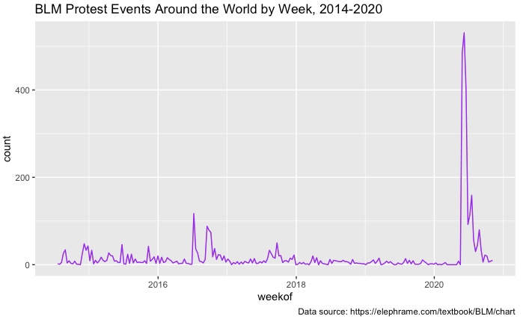
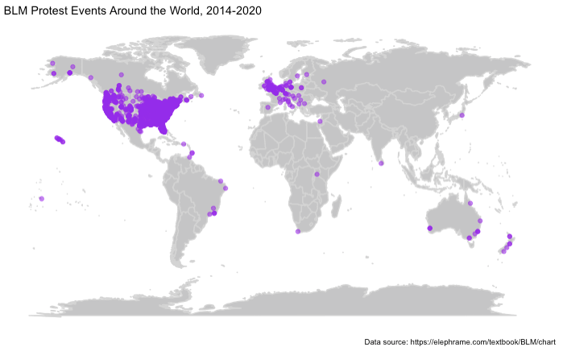
Static Visualizations: GGPLOT() & MAPS()
Notes:
These plots provided separate temporal and spatial visualizations of the data, but I needed something dynamic for showing BLM protest locations over time.

Slide 5
Dynamic Visualization: GGANIMATE()

Slide 6
Choropleth County Maps: URBNMAPR()
Notes:
Eventually, I hope to be able to run comparative analyses against BLM protest locations in 2014 and 2020, at the county level. To that end, I created cloropleth maps of county-level incidence of BLM protests in 2014 and in 2020. I used the Urban Institute’s urbnmapr() package for both the county and state spatial data and the mapping visuals.
Possible future steps:
1. Creating an R Shiny app to allow easy, interactive visualization of the spatiotemporal data
+ Including leaflet functionality for interactive maps
+ Automatically updating data from the source website as new events are added
2. Extending [Mazumder, 2019](https://osf.io/preprints/socarxiv/ap46d/) to see whether the link between BLM protests and reduced racial resentment continues to be shown in 2020.
3. Compare protest location data with:
+ Support for BLM and movement demands by location, before and after the 2020 wave.
+ Voter registration numbers by location.
+ Awareness about BLM (via geo-located Google Trends)

